Slide 1
4 Bit Binary Full Adder
Robotics 131 – Spring 2022 Online
Casey L. Raiford 27 March 2022

Slide 2
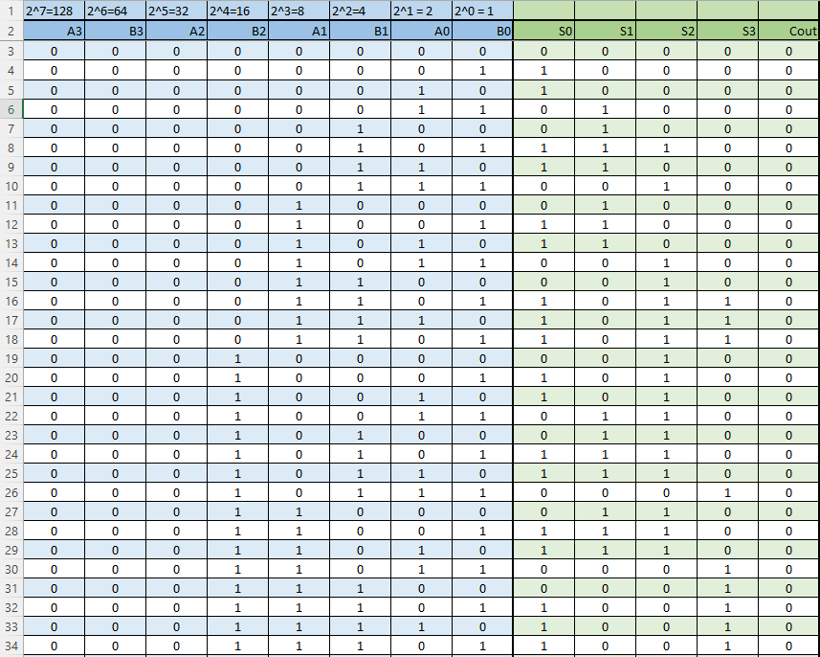
1. Truth Table lines 1-34

Slide 3
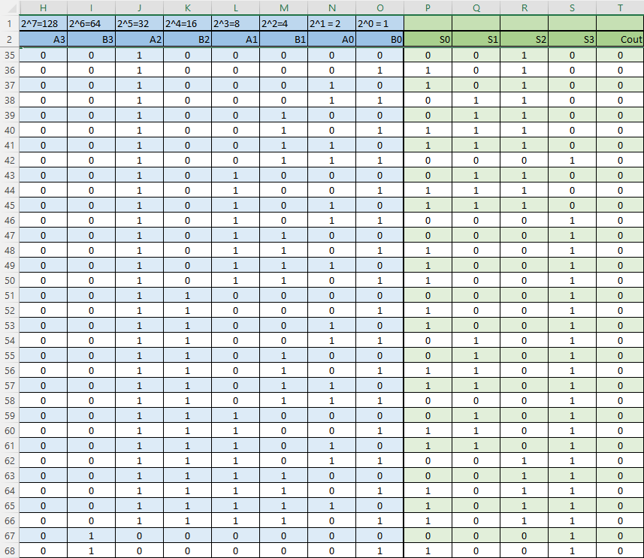
1. Truth Table lines 35-68

Slide 4
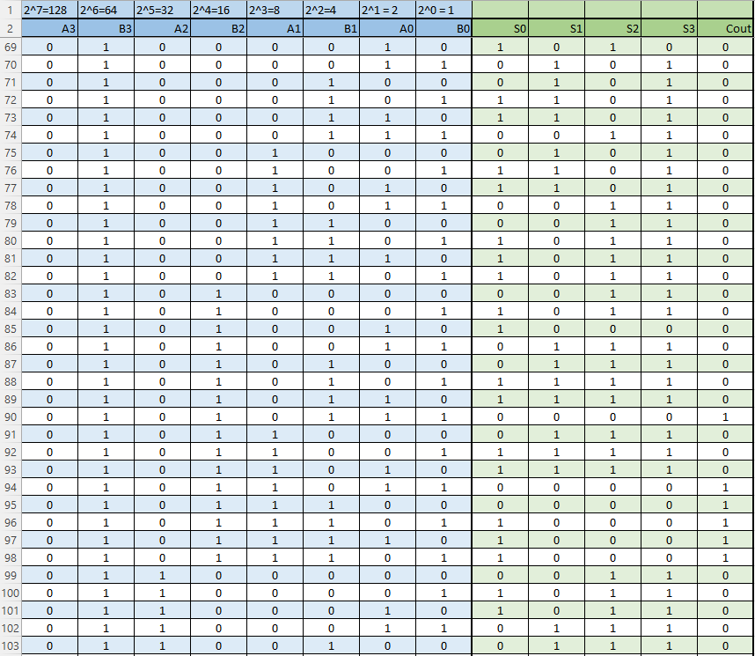
1. Truth Table lines 69-103

Slide 5
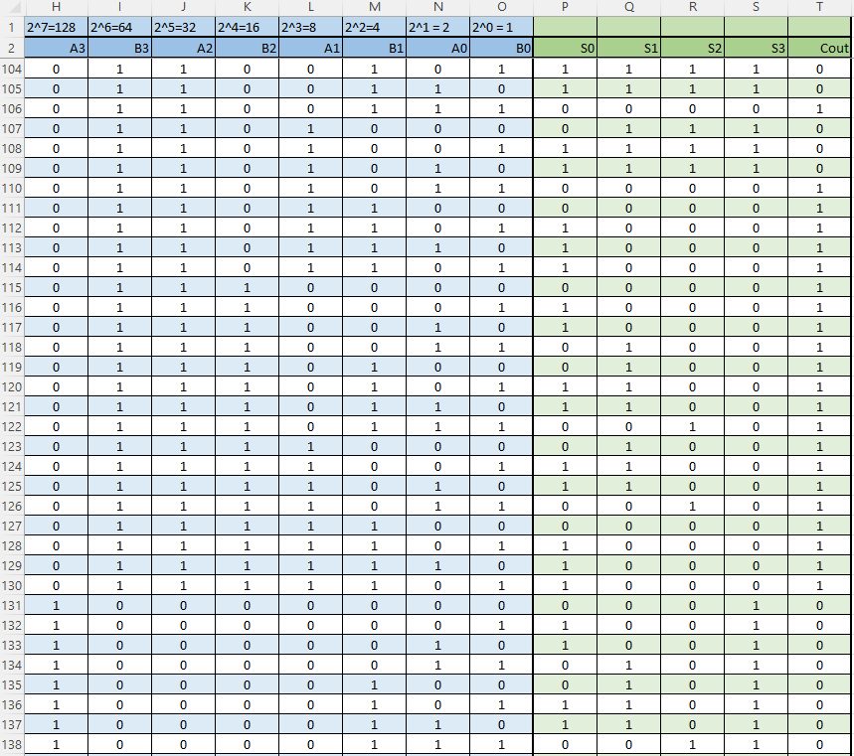
1. Truth Table lines 104-138

Slide 6
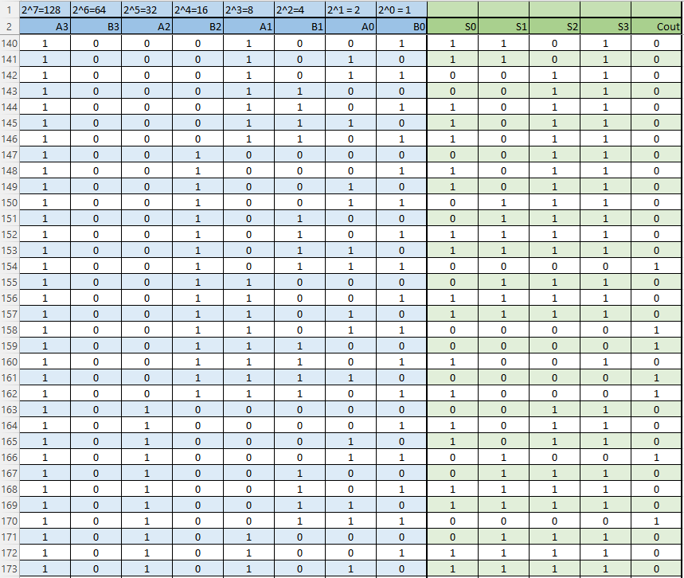
1. Truth Table lines 139-173

Slide 7
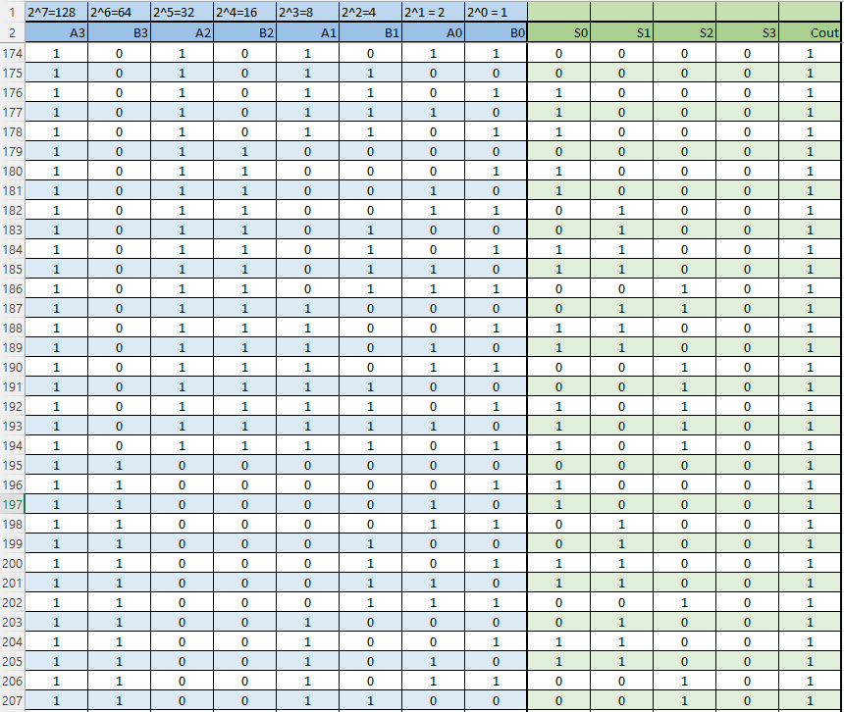
1. Truth Table lines 174-207

Slide 8
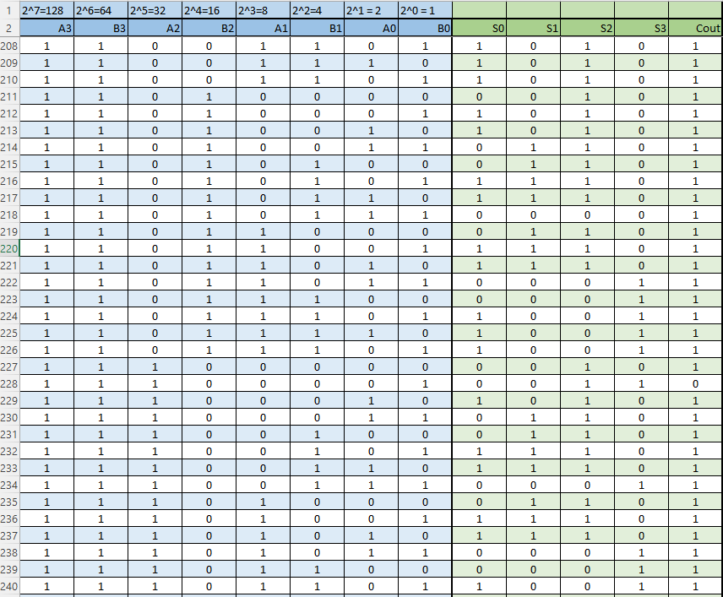
1. Truth Table lines 208-240

Slide 9
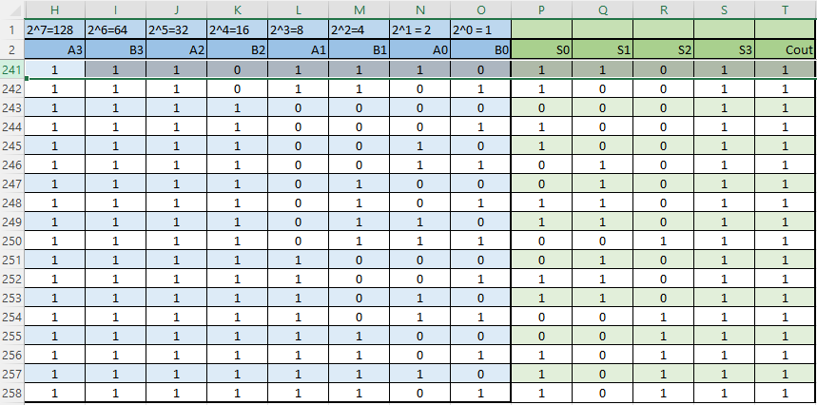
1. Truth Table lines 241-256
* It reads 258, but that count includes the two header rows

Slide 10
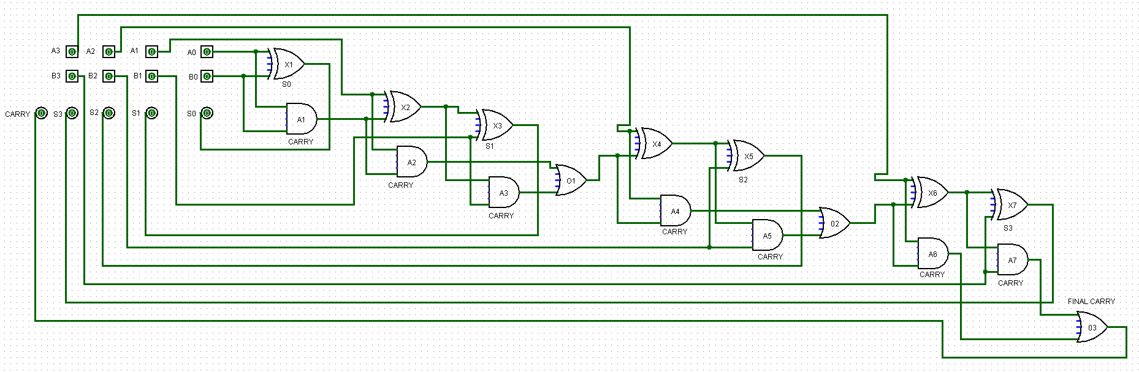
2. Create a circuit in Logisim that inputs two 4-bit binary numbers, adds them together, and then outputs the result of the addition operation.

Slide 11
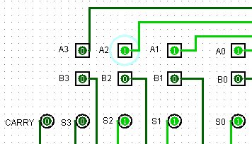
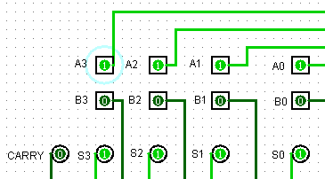
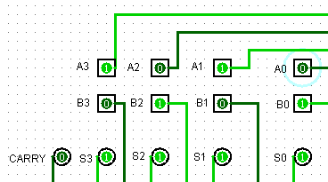
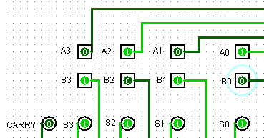
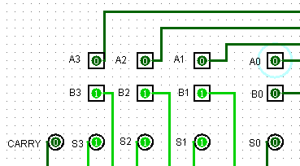
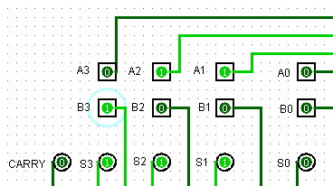
4. Provide several (8 or more) examples using different binary values and show the binary arithmetic to confirm your circuit is functioning correctly.

Slide 12
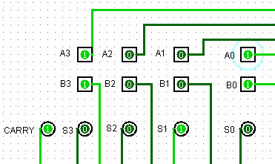
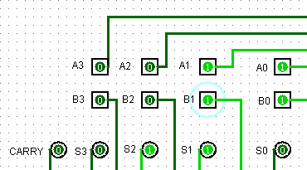
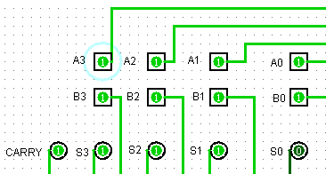
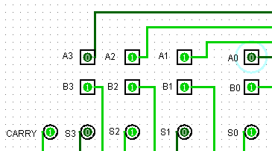
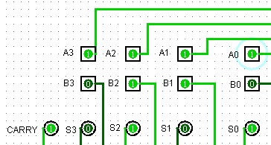
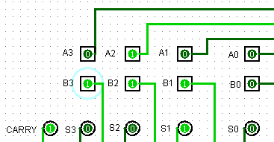
4. More sample illustrations

